Slide 1
Presentation On Critical Thinking in Web Tech Project Title : SUPERMAN
Presented By:
Sakif Ahmmed - 1610321042
Md Tanvir Hassan Bhuiyan - 1610930042
Md Siam - 1612544042
Nusrat Jahan -1612265042
Khadizatul Kubra - 1620070042
Md Sakhawat hossain - 1512017042
Mohammad Munem Shahriar Hossain -1421206042

Slide 2
Activities
Features:
1. Online Shopping (Daily goods)
2. Worker Supply.
3. Time limitation

Slide 3
User Interface: *Customer
1. Login/Signup
2. Home
3. Cart
4. Find worker
5. List of Daily goods
6. Charge for worker
7. Top selection
8. Payment
9. Rating
10. Hotline
11. Logout

Slide 4
User Interface (Worker)
1. Login/Signup
2. Orders
3. Requests
4. Payment
5. Rating
6. Logout

Slide 5
User Interface (Admin)
User Interface *Admin
1. Worker list
2. Add product
3. Add worker
4. Remove product
5. Remove worker
6. Logout

Slide 6
Actors
1. Customers
2. Workers
3. Admins

Slide 7
Priority Task
1. Building the website
2. Connecting with Google map.
3. Collecting data of selling products.
4. Collecting workers
5. Training workers
6. Marketing

Slide 8
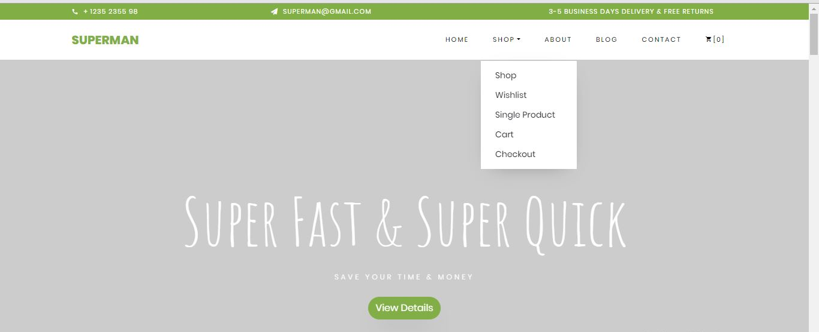
Progress :

Slide 9
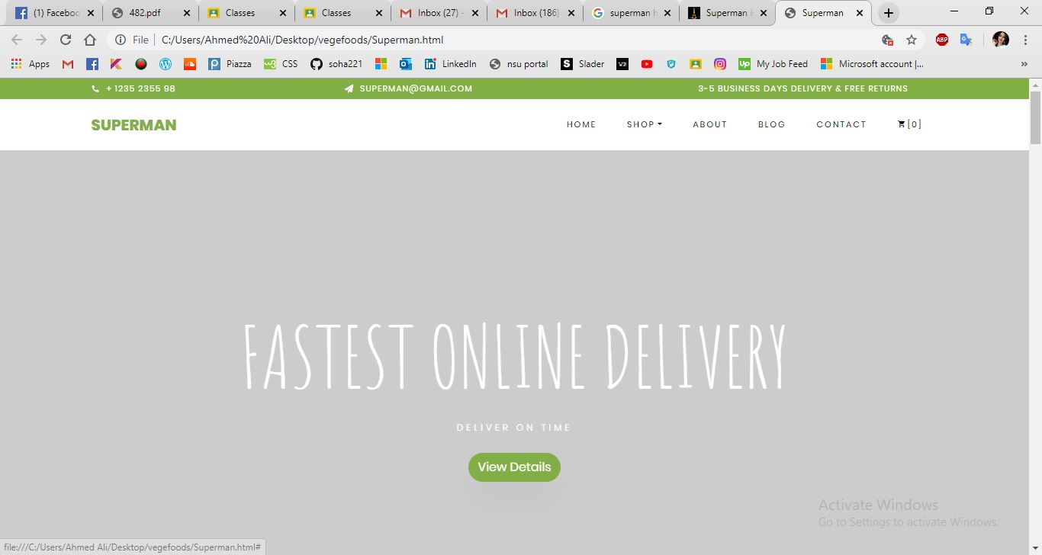

Slide 10
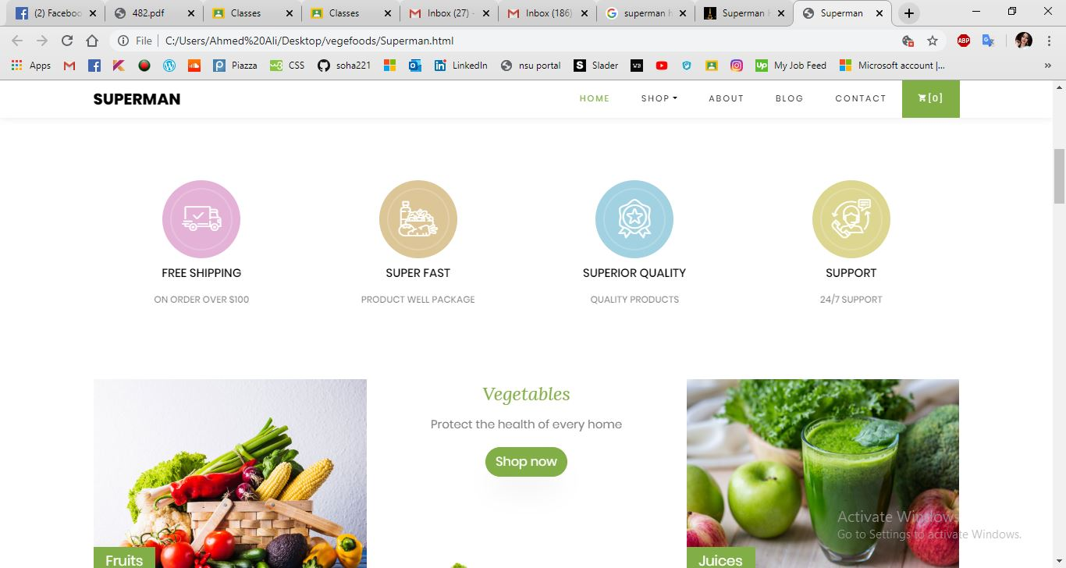

Slide 11
